Slide 1
Ensemble dimensionality reduction and feature gene extraction for single-cell RNA-seq data
Oct. 21, 2022
Gwangwoo Kim

Slide 2
Introduction
The dimensionality reduction methods consist of two major types, linear and nonlinear techniques.
PCA -> overcrowding representation
t-SNE -> suffering from losing the global geometry
UMAP -> inefficient
Ensemble Dimensionality reduction and feature Gene Extraction (EDGE) -> DR and feature gene identification,

Slide 3
Method: Similarity Search
Randomly select B genes out of all genes
Randomly pick a gene-specific threshold within the range of all values of gene expression matrix
Calculate a sketch vector V for each cell
0
0
1

Slide 4
Method: Similarity Search
For a randomly generated weight vector W, the dot product of V and W modulo H (predefined) is now stored in an imaginary box.
0
0
1
W
/H

Slide 5
Method: Similarity Search
For a randomly generated weight vector W, the dot product of V and W modulo H (predefined) is now stored in an imaginary box.
2
1
2
1
Similarity matrix

Slide 6
Method: Similarity Search
Repeat this procedure and average over all matrices
And now, mimic the optimization step of the UMAP!
S

Slide 7
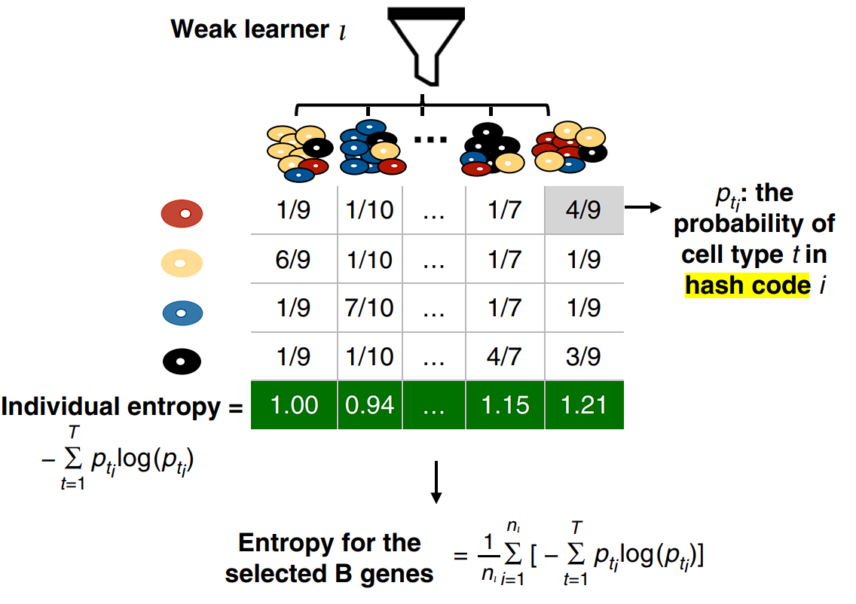
Method: Feature Gene Selection
Step 1: A clustering algorithm is applied to the optimized embedding matrix. We have the predicted labels.
Step 2:

Slide 8
Method: Feature Gene Selection
Step 3: We choose μ − 1.5 × σ as the cutoff value to select top feature genes.

Slide 9
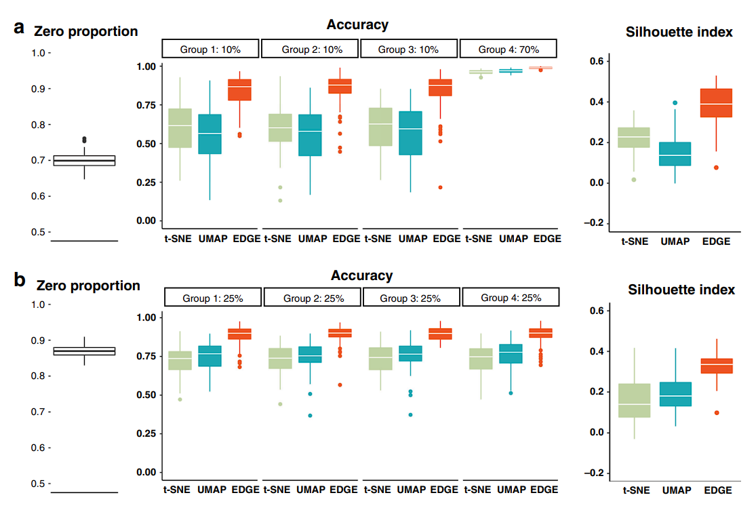
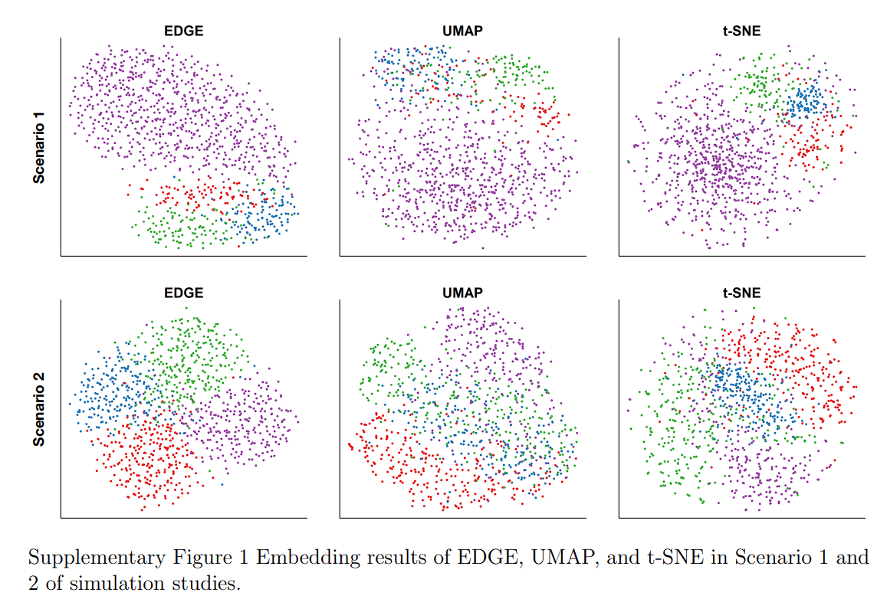
Experiments

Slide 10
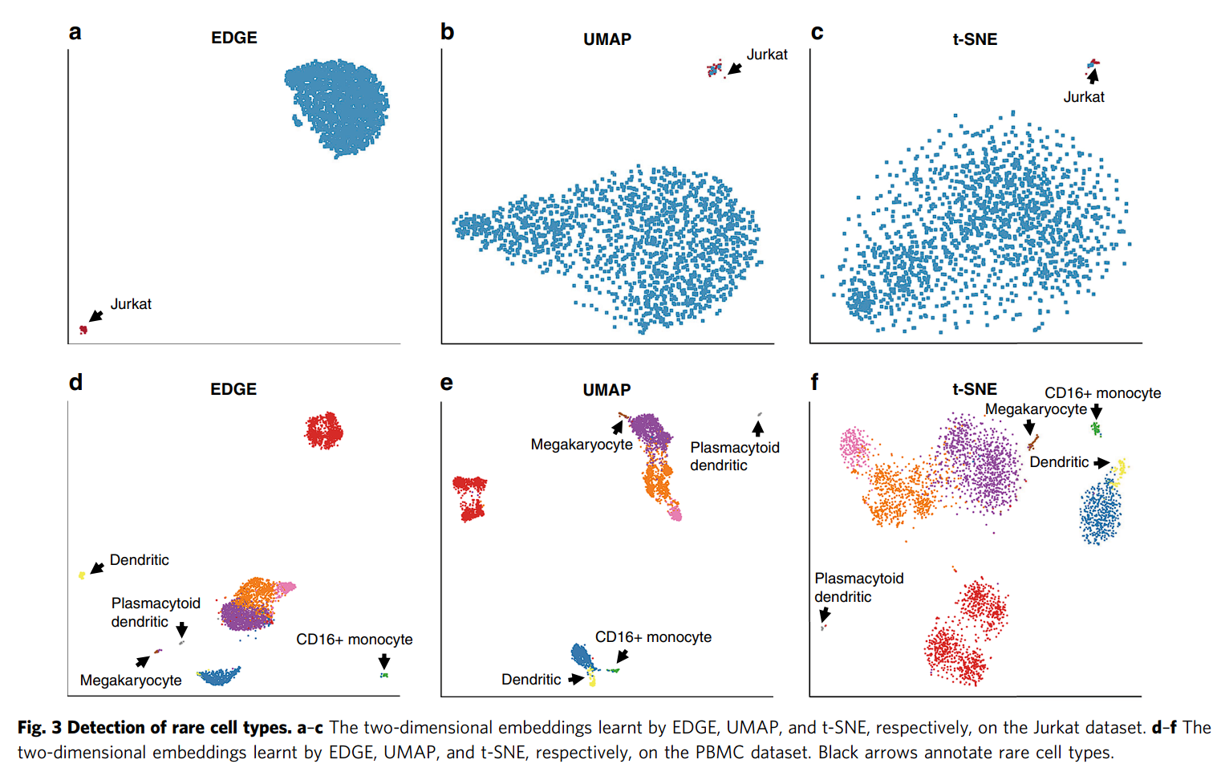
Experiments

Slide 11
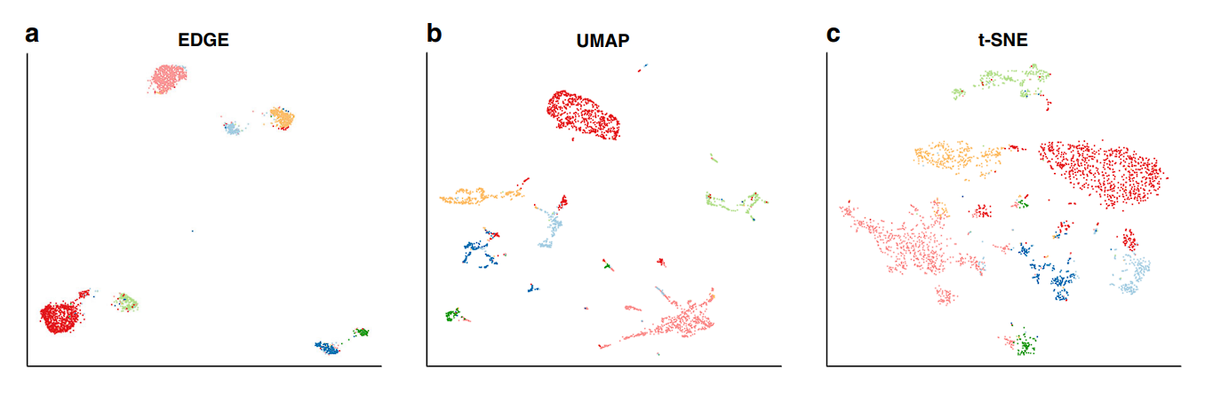
Experiments
Cortex dataset
ASW: 0.62, 0.59, 0.50

Slide 12
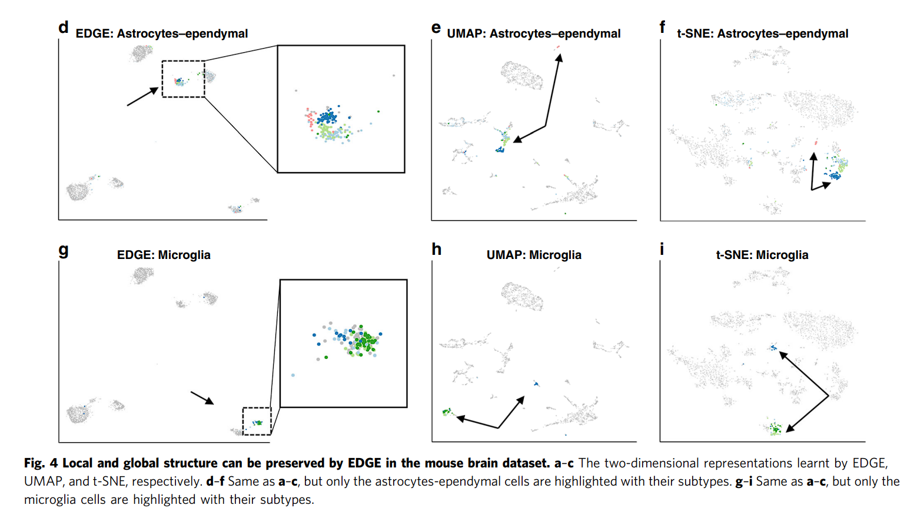
Experiments
EDGE showed promising results in maintaining hierarchical structures of cells.

Slide 13
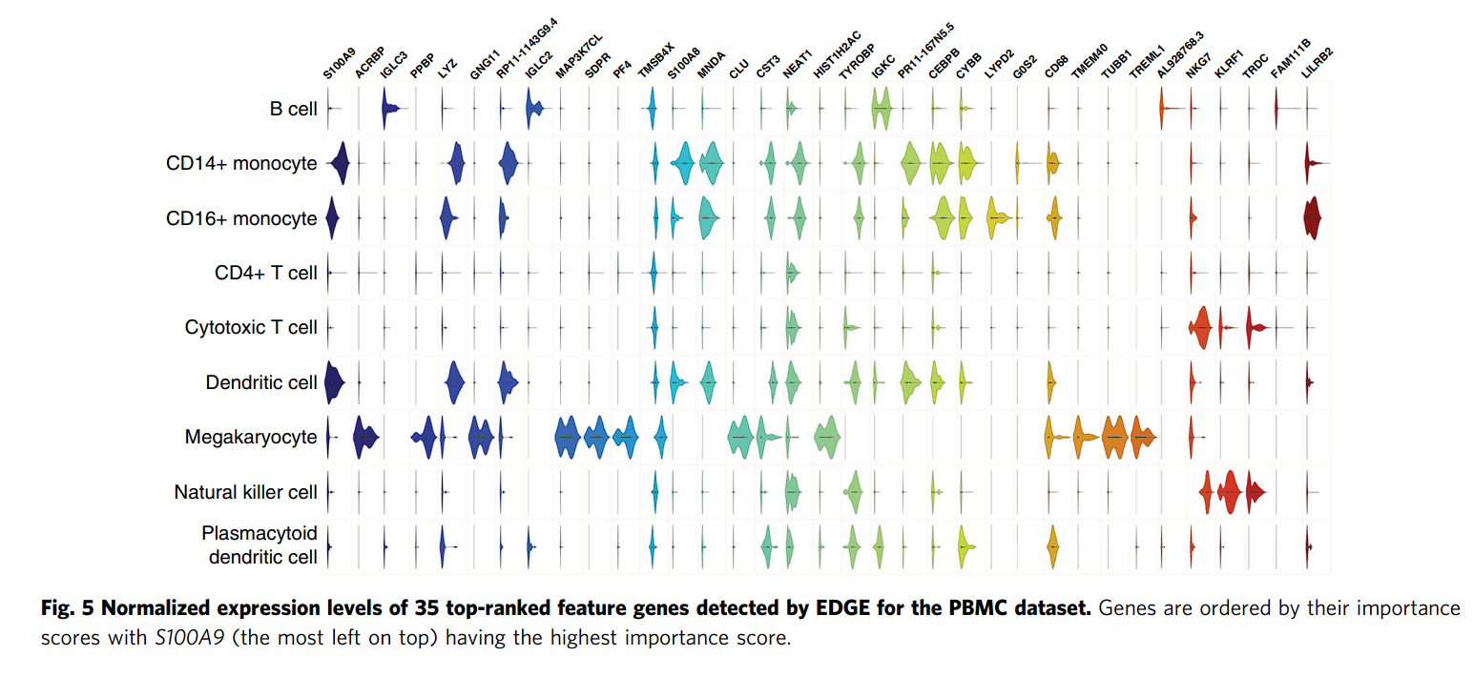
Experiments

